Slide 1
St. Louis Building Permits
Monthly Report: January 2020 Washington University Medical Center

Slide 2
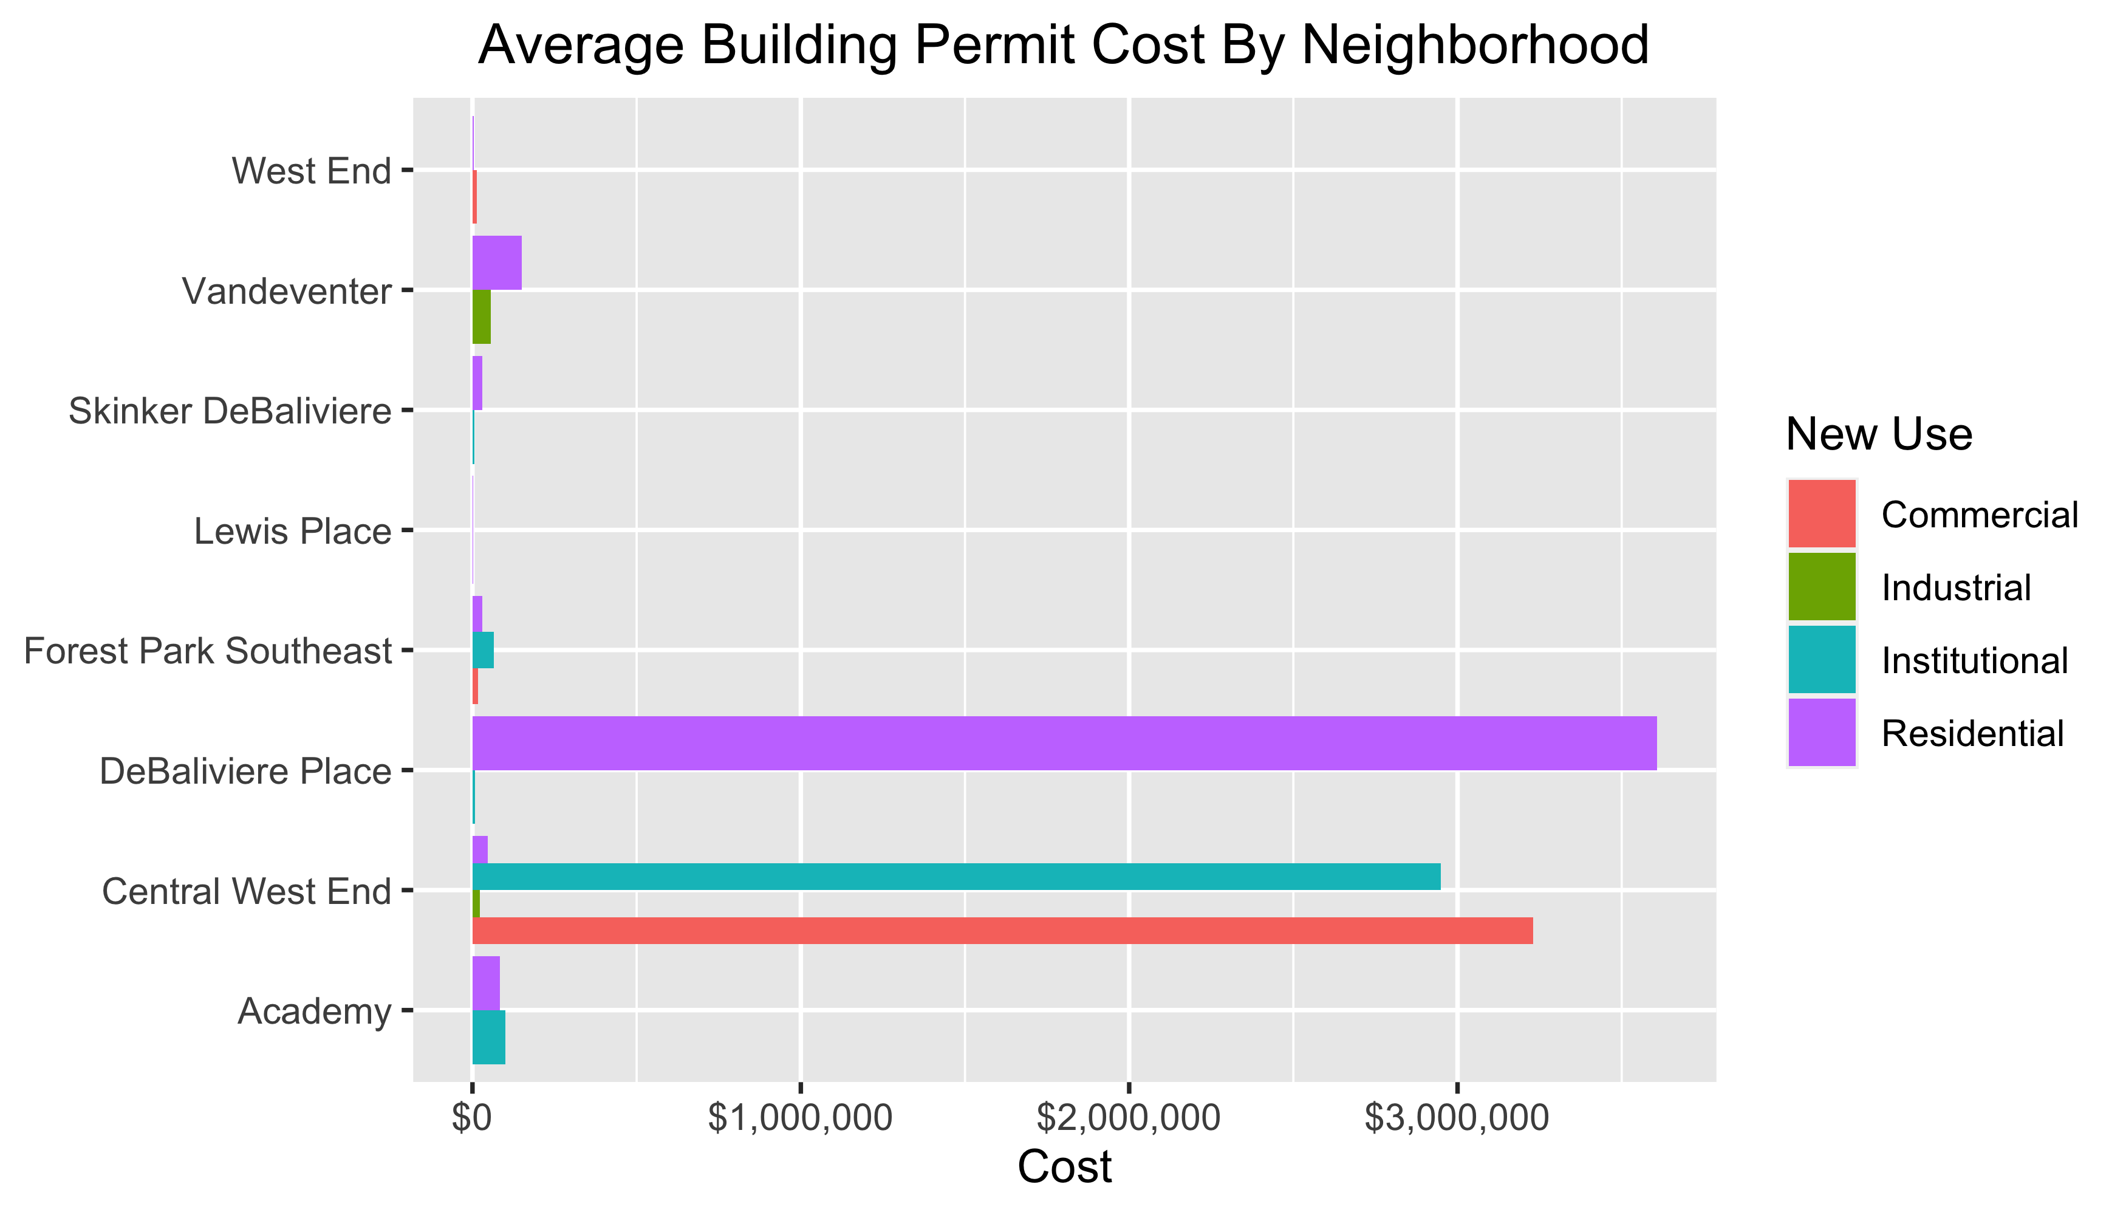
Neighborhood Summary

Slide 3
Forest Park Southeast
13 building permits in Forest Park Southeast in January 2020

Slide 4
Owner | New Use | Cost | Address
MITCHELL, TIMOTHY J | Residential | $3,000 | 4535 OAKLAND AV
ROBBINS, ARNOLD J & TERRIE L | Residential | $250,000 | 4353 HUNT AV
CITY DOGS REALTY LLC | Residential | $0 | 4322 VISTA AV
ALBIN, MICHAEL & LISA | Residential | $3,990 | 4227 SWAN AV
MAY CUSTOM PROPERTIES LLC | Residential | $0 | 4340 SWAN AV
TISOTO, JEFFREY & LYNNE | Commercial | $15,000 | 4523 GIBSON AV
WASHINGTON UNIVERSITY | Institutional | $64,145 | 1234 S KINGSHIGHWAY BLVD
VITT, VICTOR J JR | Residential | $9,000 | 4366 HUNT AV
1041 TAYLOR LLC | Residential | $0 | 1045 S TAYLOR AV
4176 MANCHESTER LLC | Commercial | $20,000 | 4176 MANCHESTER AV
ROWELL, JASON | Residential | $0 | 1125 KENTUCKY AV
KAMPE, NICHOLAS R | Residential | $30,000 | 4448 CHOUTEAU AV
JOHNSON, ISAIAH & CALLIE | Residential | $1,000 | 4327 GIBSON AV

Slide 5
New Use | Average Cost | Permit Count
Commercial | $17,500 | 2
Institutional | $64,145 | 1
Residential | $29,699 | 10

Slide 6
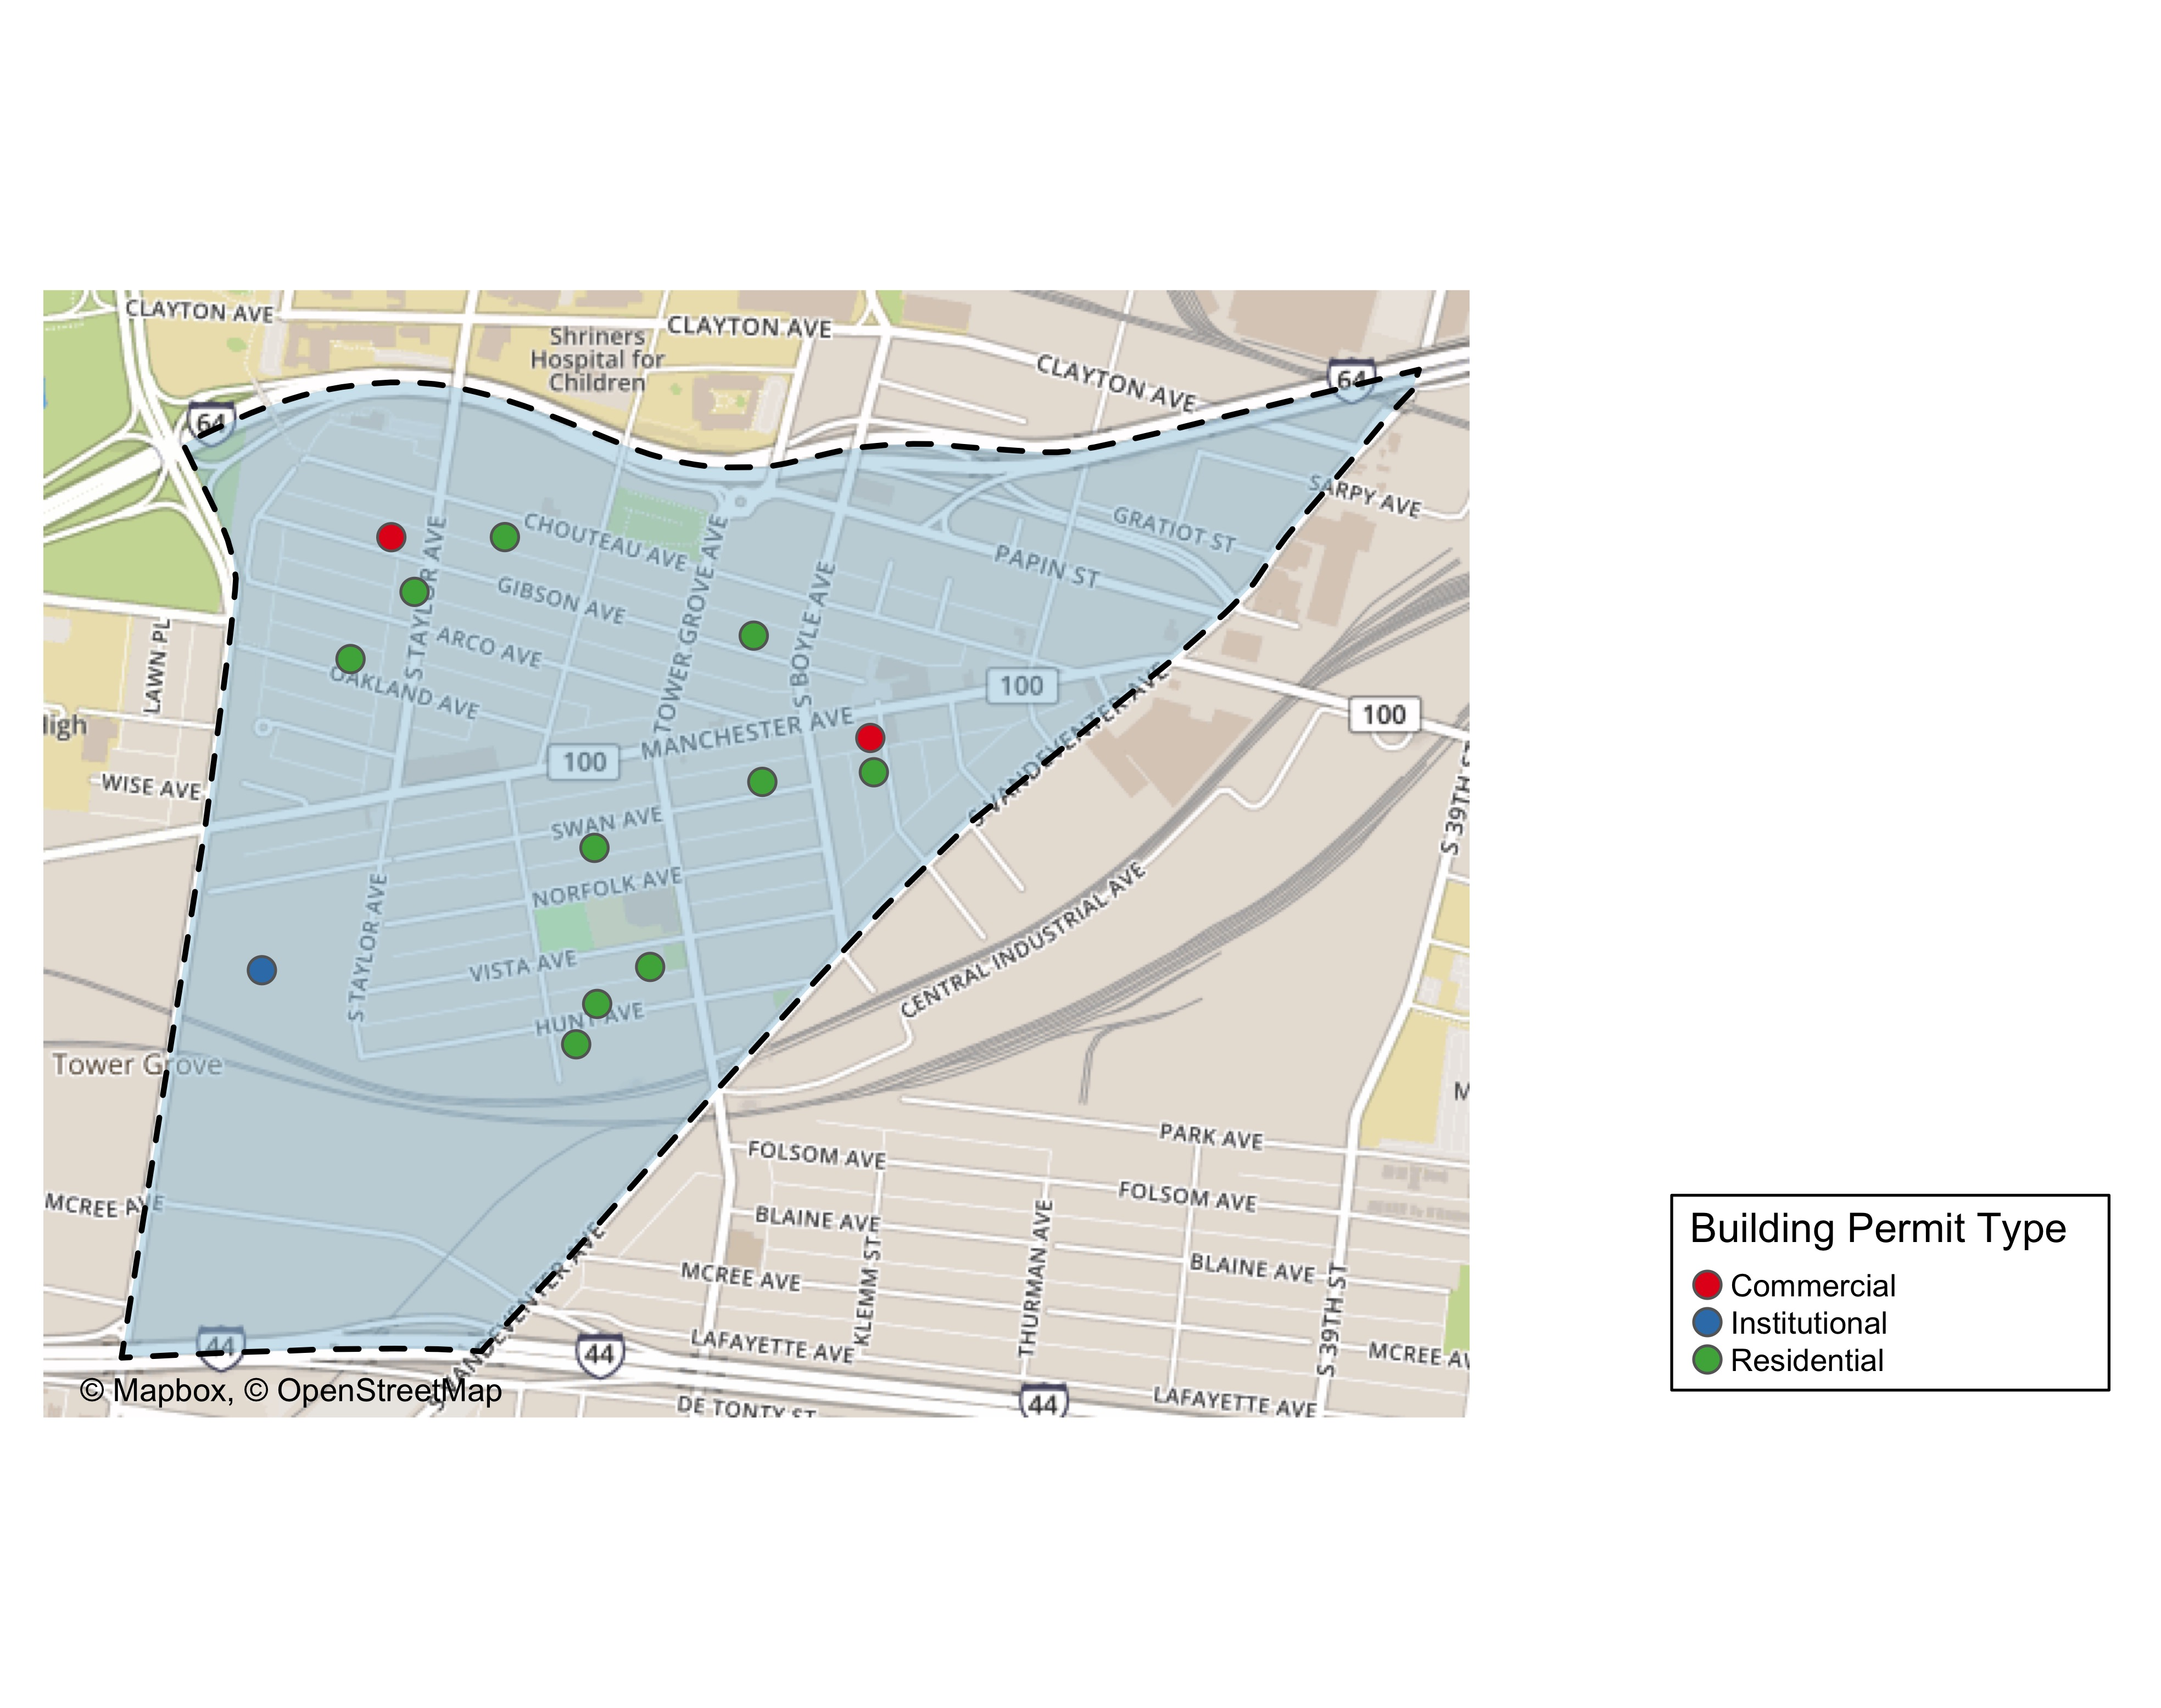

Slide 7
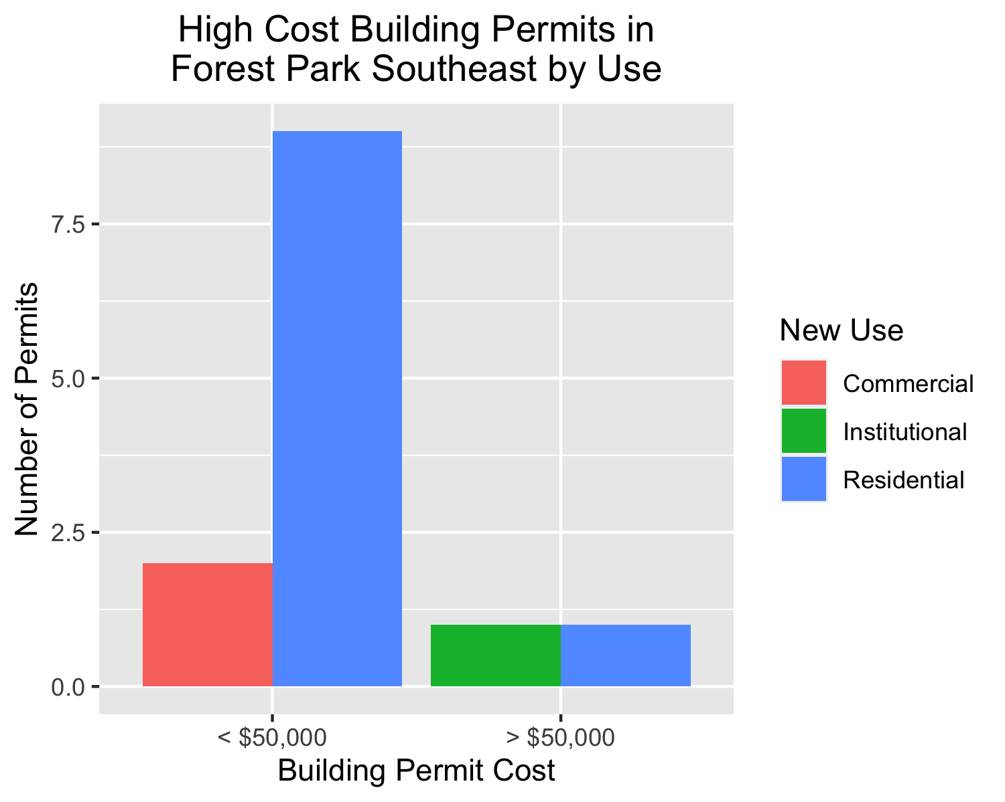

Slide 8
Central West End
40 building permits in Central West End in January 2020

Slide 9
New Use | Average Cost | Permit Count
Commercial | $3,230,000 | 5
Industrial | $21,676 | 1
Institutional | $2,948,967 | 16
Residential | $47,000 | 18

Slide 10
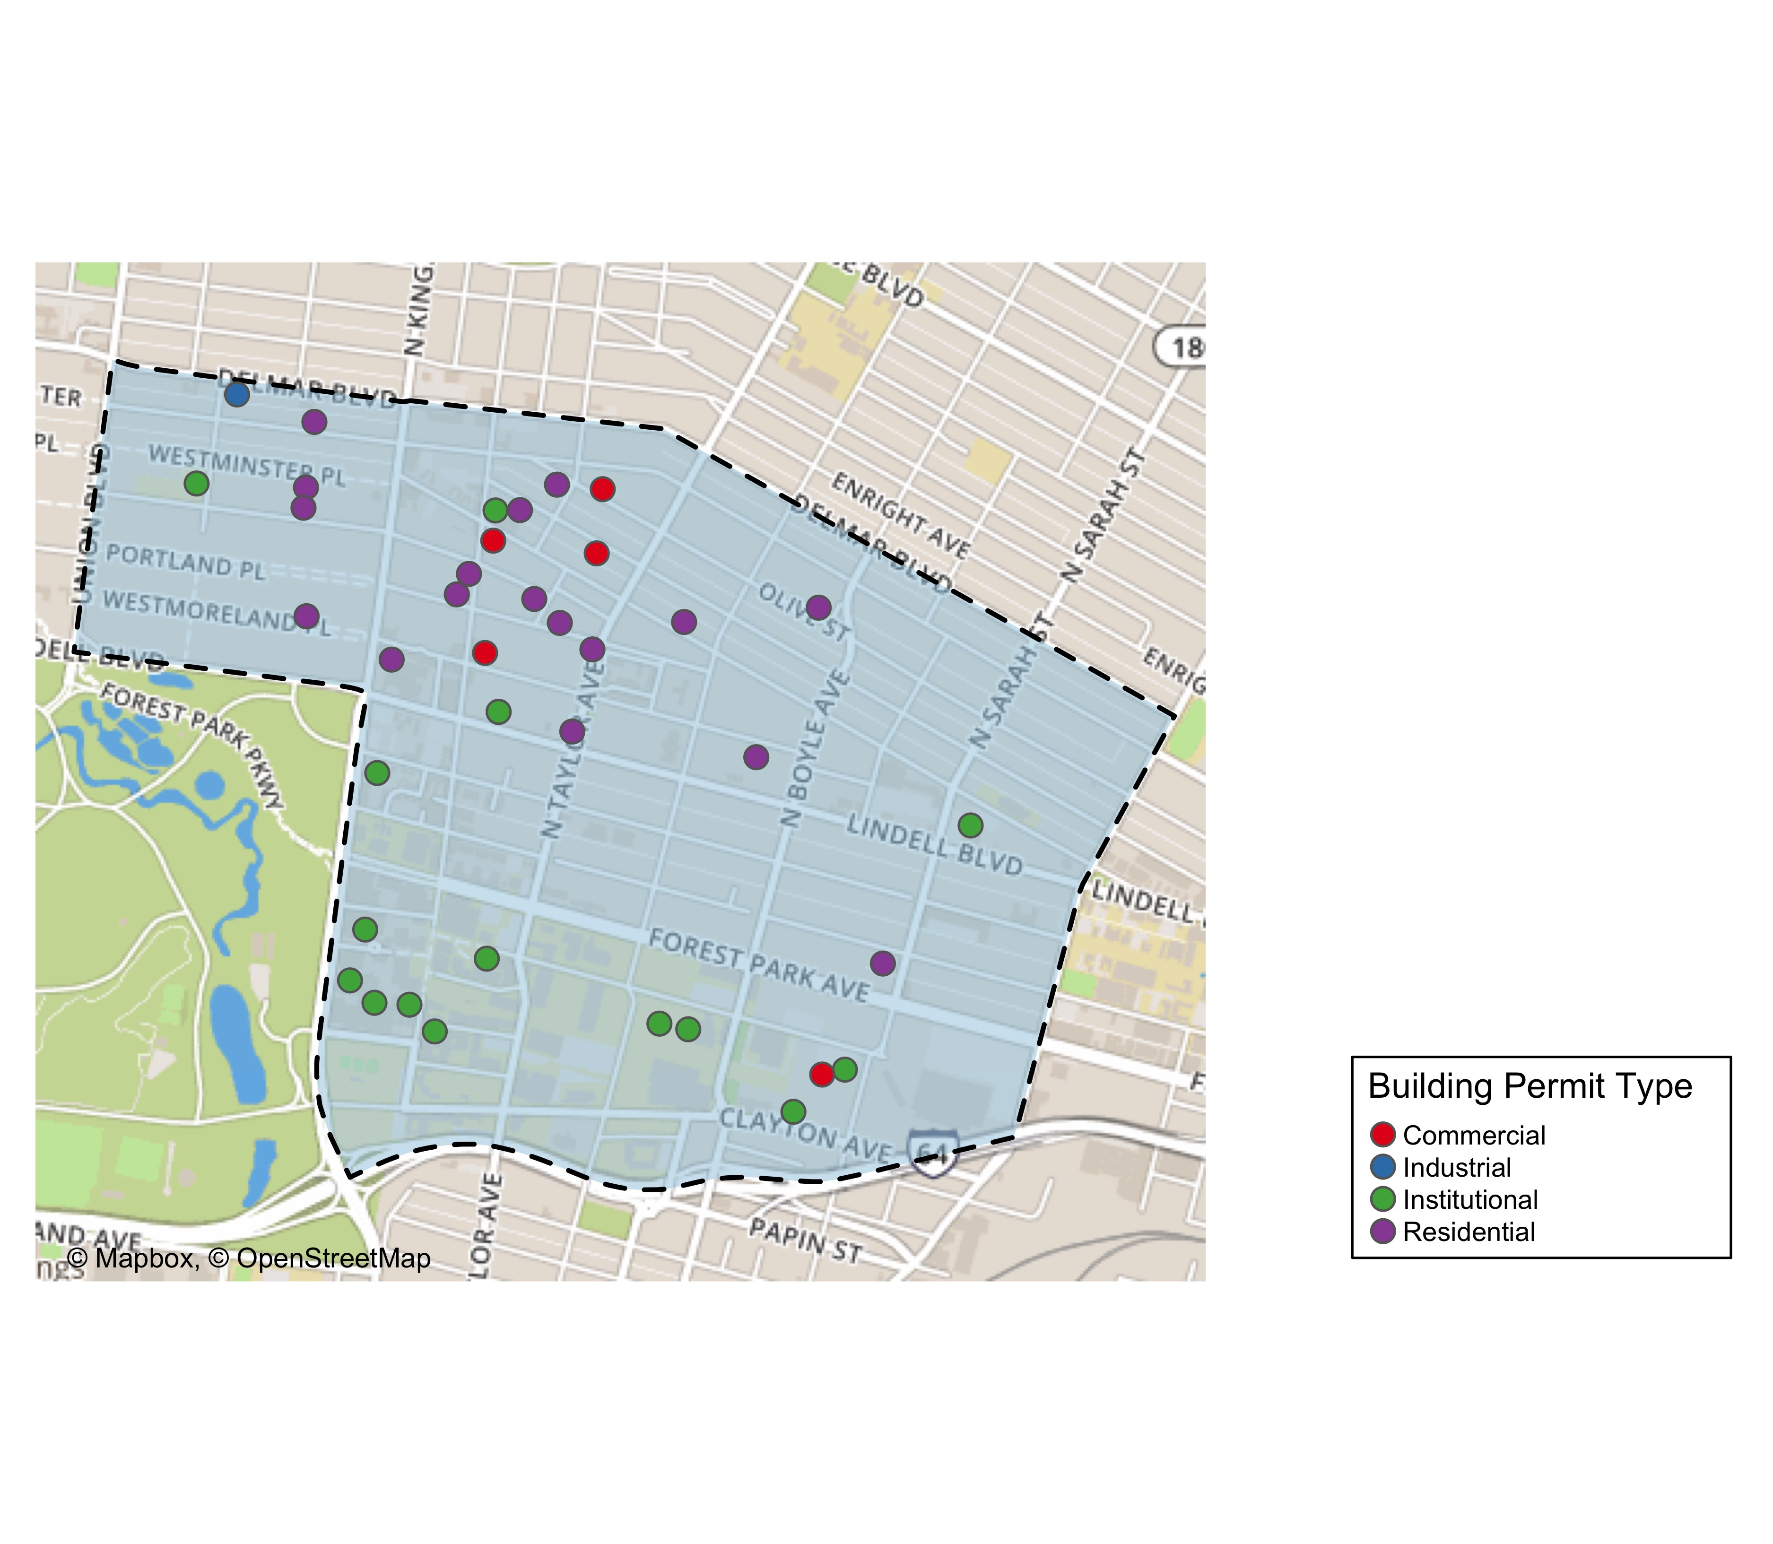

Slide 11
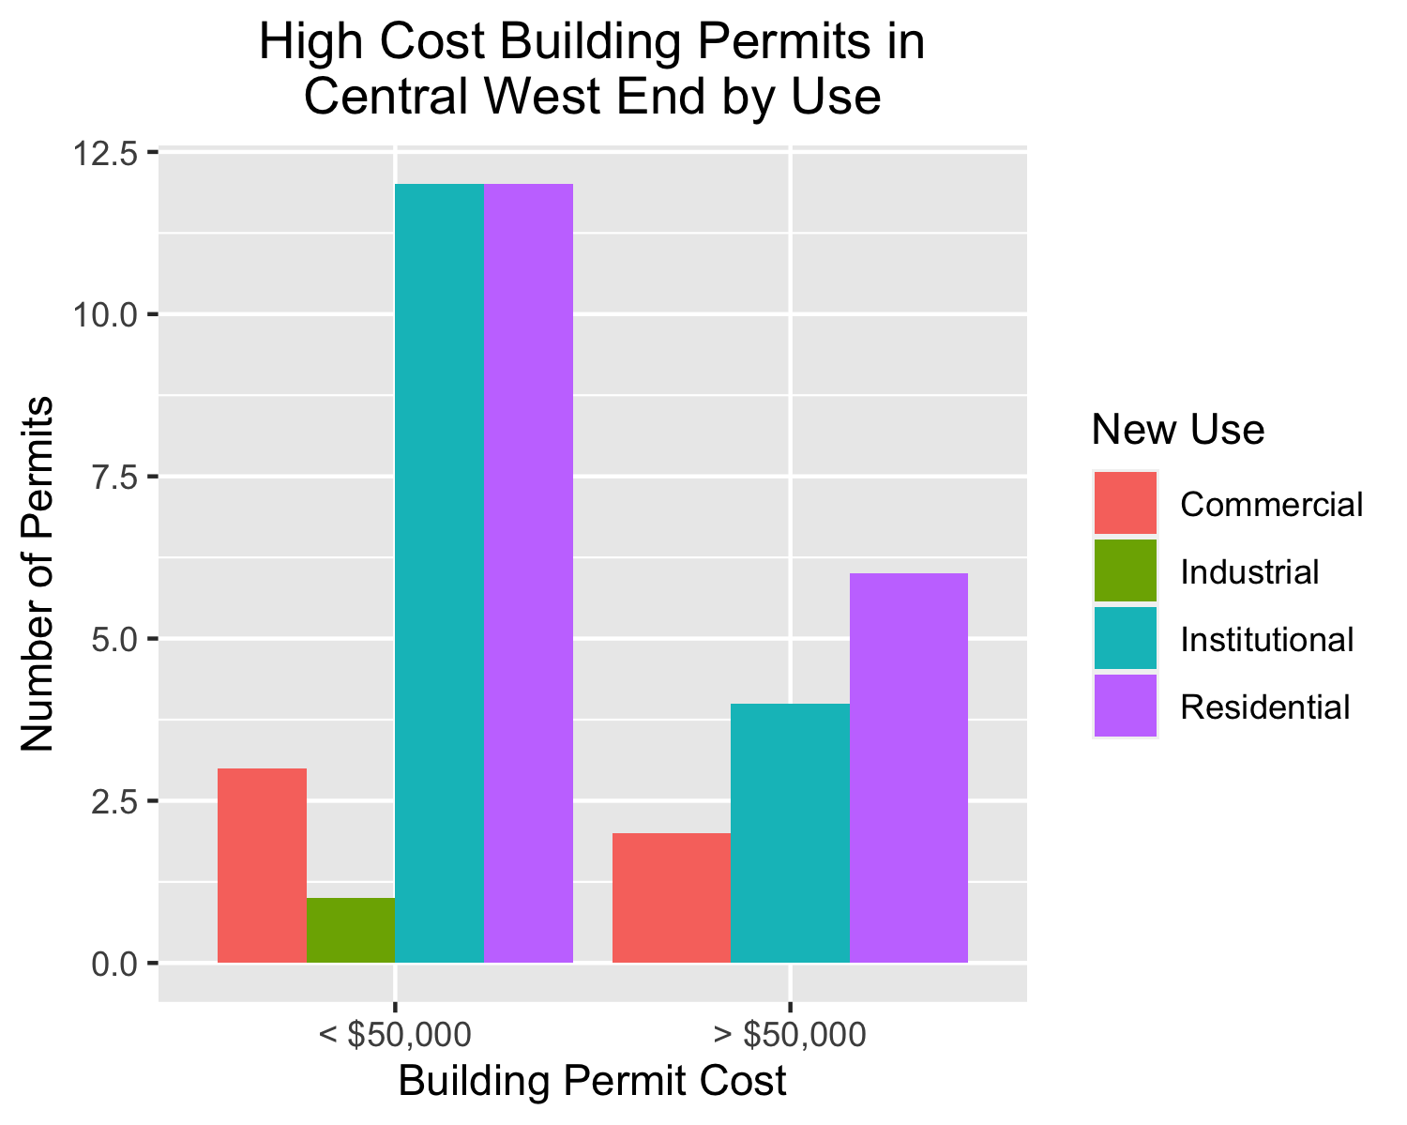

Slide 12
DeBaliviere Place
6 building permits in DeBaliviere Place in January 2020

Slide 13
Owner | New Use | Cost | Address
DEL MONTE APARTMENTS LLC | Institutional | $8,000 | 5622 DELMAR BLVD
WATERMAN-KINGSBURY CONDOMINIUM | Residential | $0 | 5696 KINGSBURY AV
CALHOUN, BARRY & SHIRA SPETNER | Residential | $5,000 | 10 WASHINGTON TER
REAL ESTATE INVESTOR WHOLESALE LLC | Residential | $0 | 5612-5624 WATERMAN BLVD
REDIGER, DOUGLAS HTRS | Residential | $35,000 | 5373 LINDELL BLVD
KILAMANJARO V LLC | Residential | $18,000,000 | 5637 PERSHING AV

Slide 14
New Use | Average Cost | Permit Count
Institutional | $8,000 | 1
Residential | $3,608,000 | 5

Slide 15
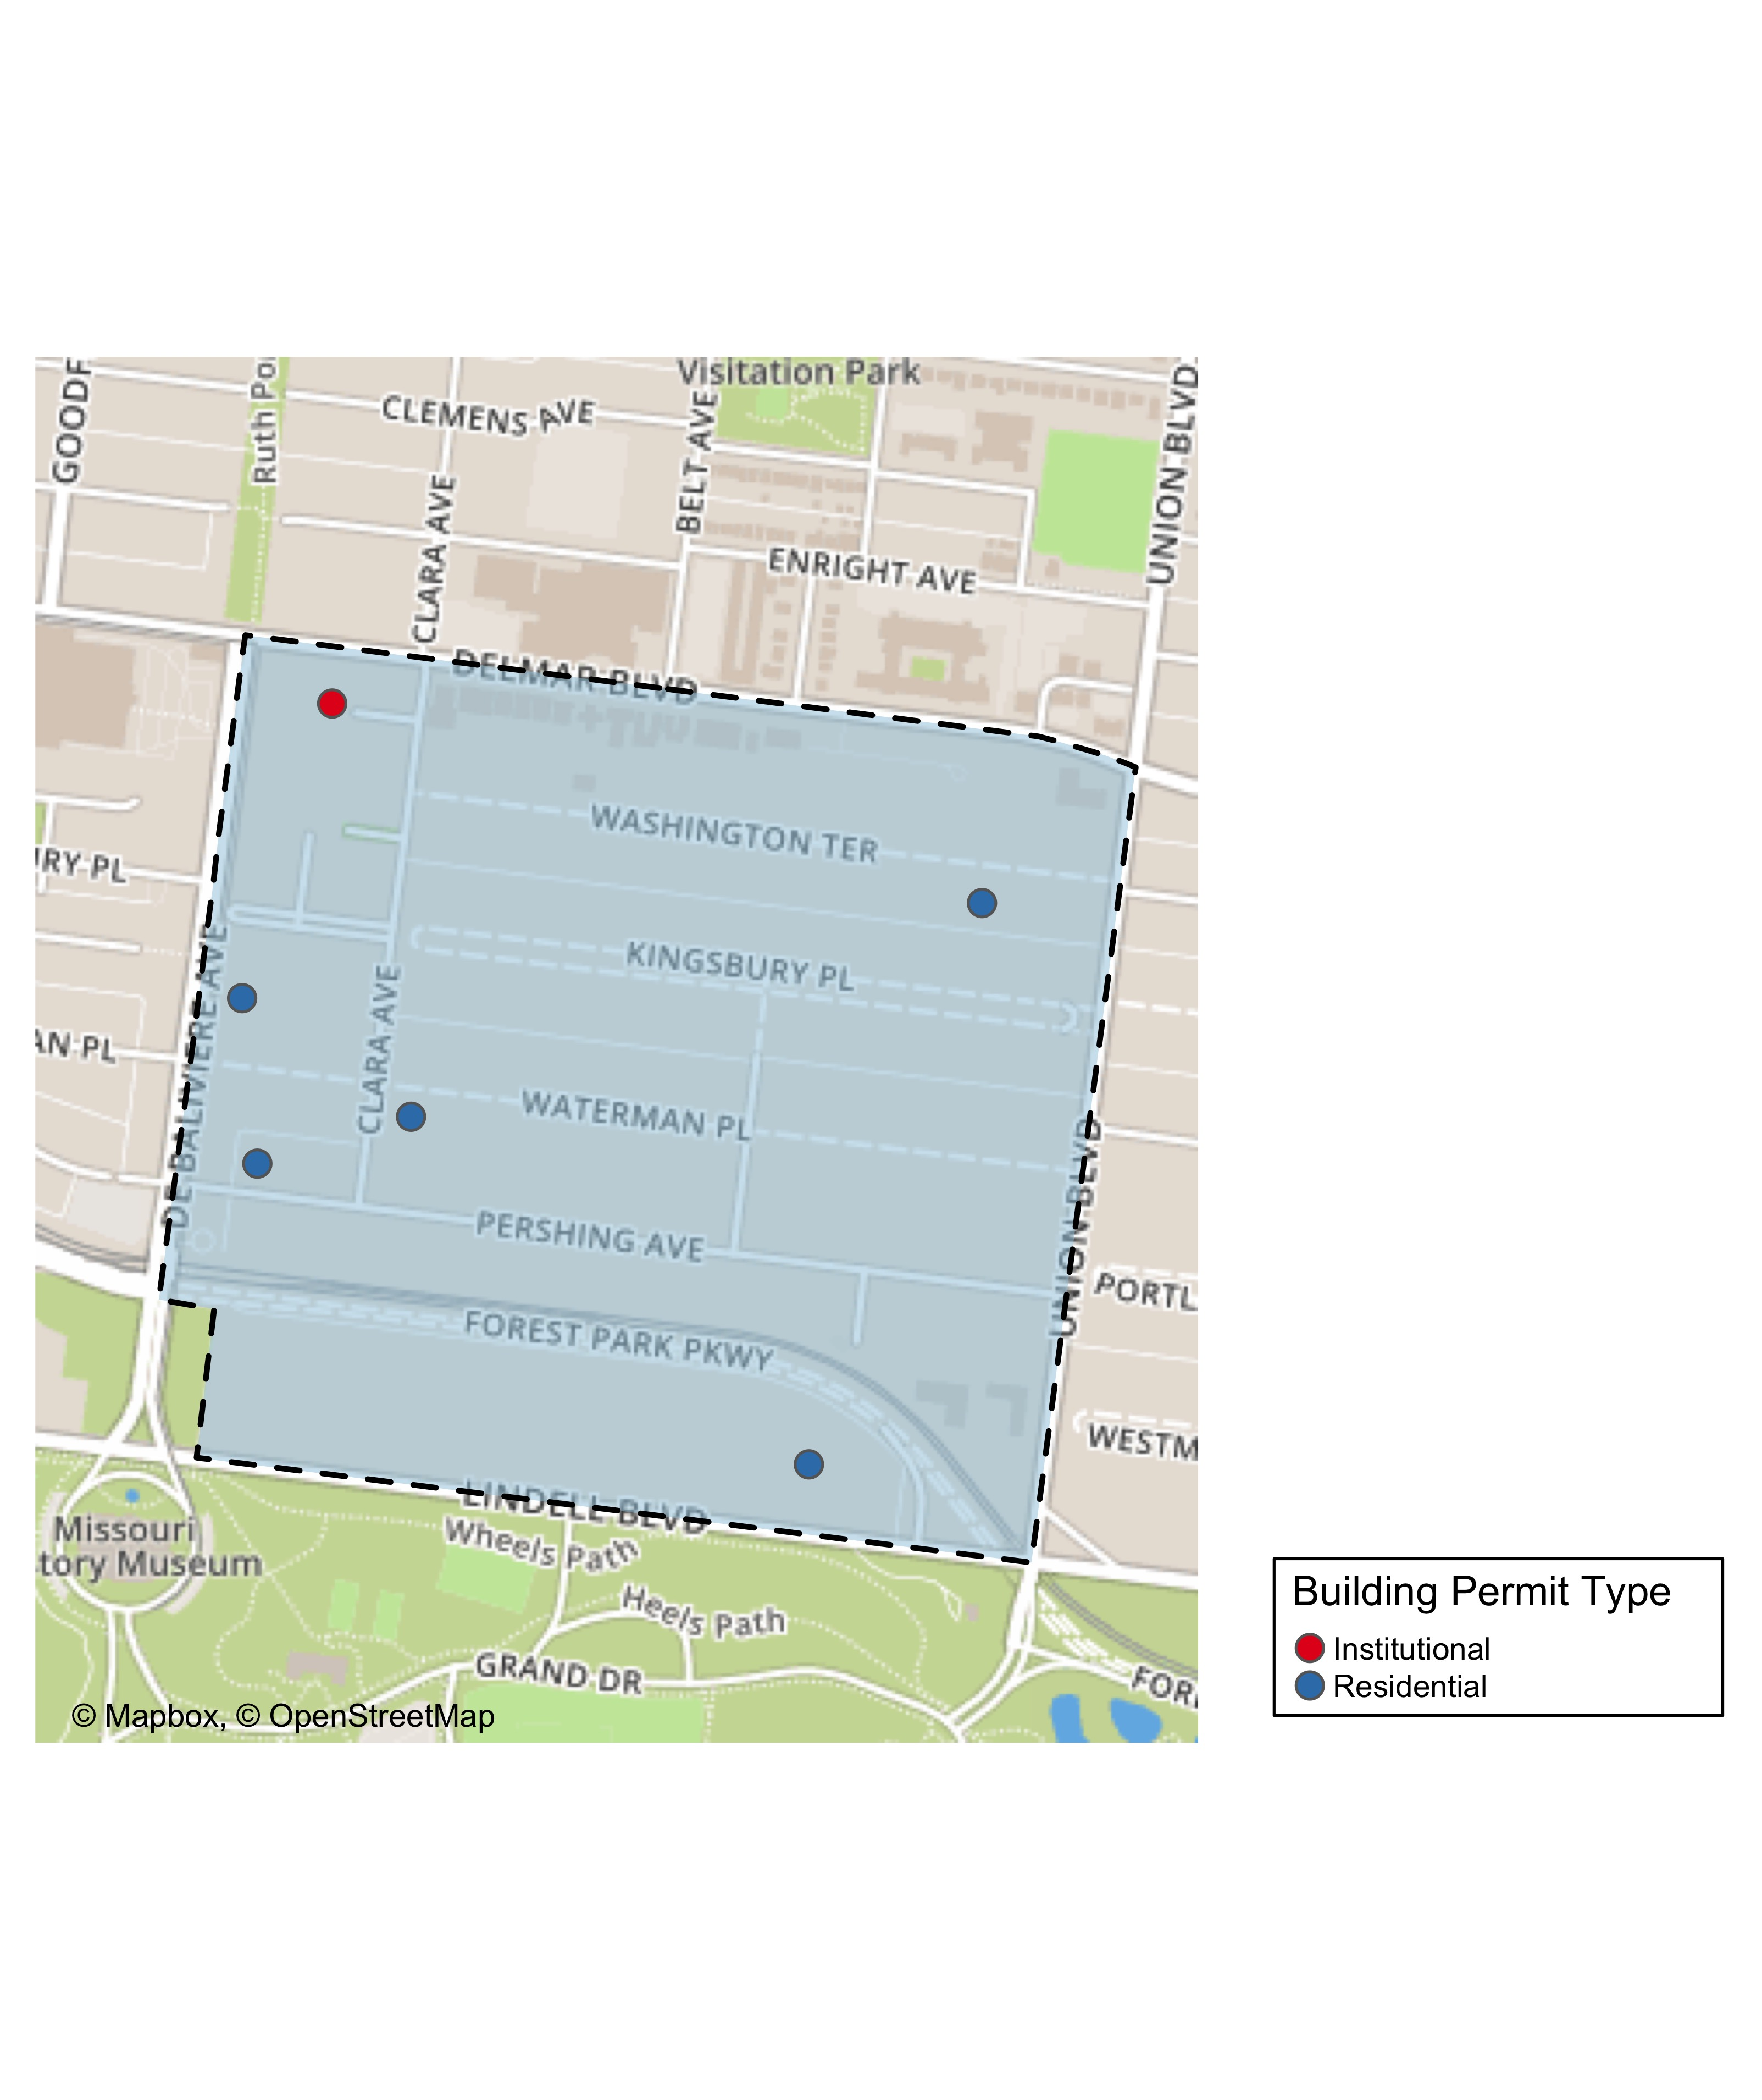

Slide 16
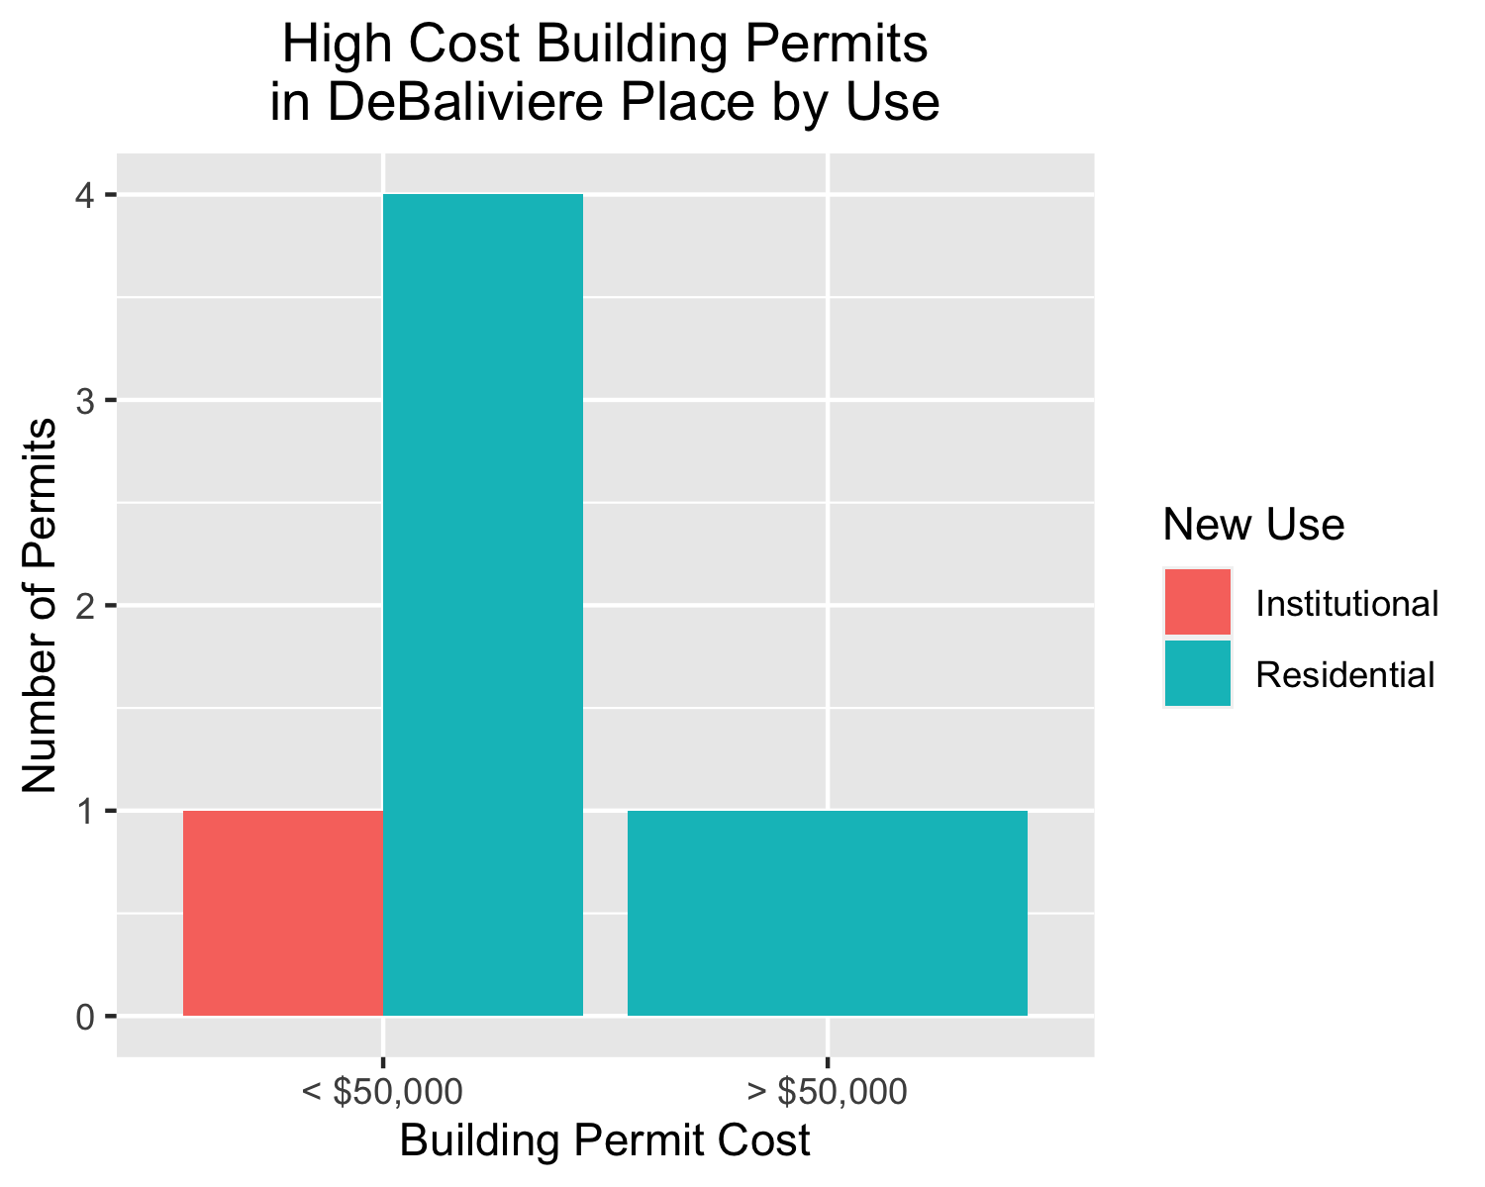

Slide 17
Skinker DeBaliviere
8 building permits in Skinker DeBaliviere in January 2020

Slide 18
Owner | New Use | Cost | Address
WASHINGTON UNIVERSITY ART BUILDING | Institutional | $10,000 | 6220 FOREST PARK PARKWAY
DEE, MICHAEL PATRICK & | Residential | $76,500 | 6232 MCPHERSON AV
HOFFMAN, CHERI L | Residential | $27,000 | 6211 WESTMINSTER PL
WELCH, MARGARET & MARY LOU | Residential | $17,500 | 6189 KINGSBURY AV
ONE WORLD - USA, LLC | Residential | $33,000 | 5948 PERSHING AV
ONE WORLD - USA, LLC | Residential | $14,000 | 5948 PERSHING AV
WASHINGTON UNIVERSITY ART BUILDING | Institutional | $0 | 6220 FOREST PARK PARKWAY
DEE, MICHAEL PATRICK & | Residential | $15,000 | 6232 MCPHERSON AV

Slide 19
New Use | Average Cost | Permit Count
Institutional | $5,000 | 2
Residential | $30,500 | 6

Slide 20
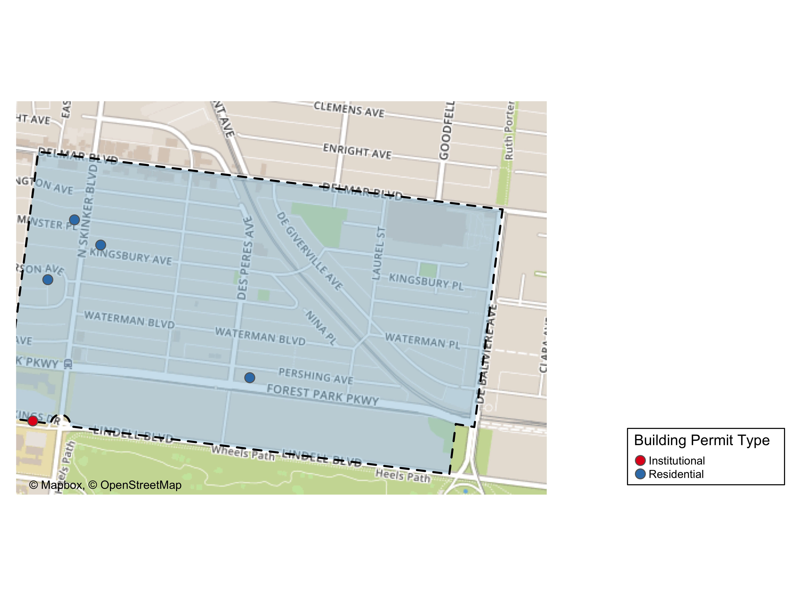

Slide 21
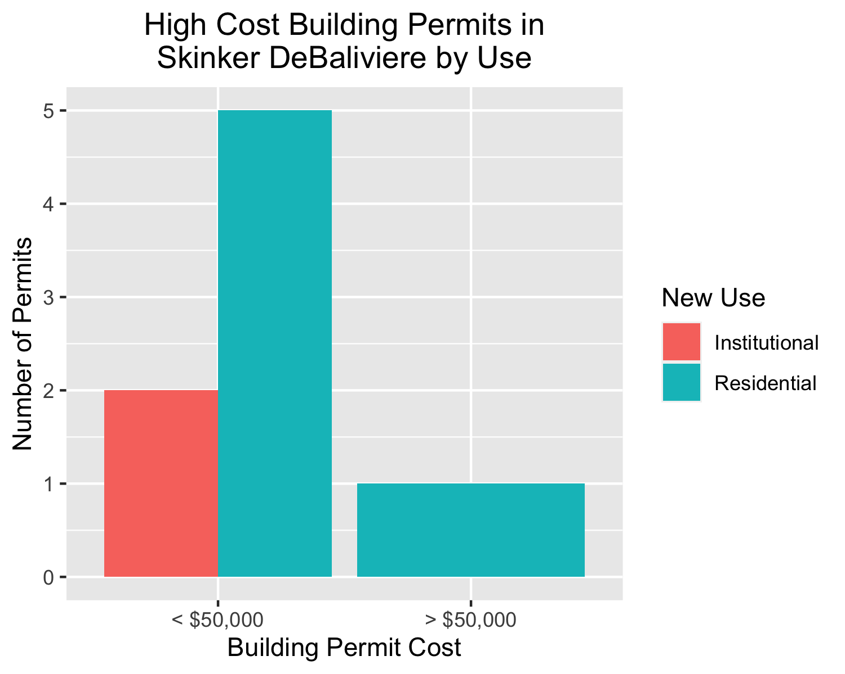

Slide 22
West End
12 building permits in West End in January 2020

Slide 23
Owner | New Use | Cost | Address
KEY MASTERS LLC | Residential | $2,000 | 5647 VERNON AV
THREE DOORS PROPERTIES LLC | Residential | $30,000 | 6018 HORTON PL
STRONG, ERNEST E & CASSANDRA A | Residential | $0 | 942 BEACH AV
WESTEND CATES LLC | Residential | $1,000 | 6062 CATES AV
WESTEND CHAMBERLAIN LLC | Residential | $1,000 | 5561-5565 CHAMBERLAIN AV
WESTEND CHAMBERLAIN LLC | Residential | $1,000 | 5569-5571 CHAMBERLAIN AV
WESTEND HAMILTON LLC | Residential | $1,000 | 5902-5906 HORTON PL
WESTEND HAMILTON LLC | Residential | $1,000 | 1019-1021 HAMILTON AV
WESTEND HAMILTON LLC | Residential | $1,000 | 1023-1025 HAMILTON AV
PACE-DELMAR ASSOCIATES LLC | Commercial | $32,000 | 6211 DELMAR BLVD
PACE-DELMAR ASSOCIATES LLC | Commercial | $0 | 621 N SKINKER BLVD
PACE-DELMAR ASSOCIATES LLC | Commercial | $10,000 | 621 N SKINKER BLVD

Slide 24
New Use | Average Cost | Permit Count
Commercial | $14,000 | 3
Residential | $4,222 | 9

Slide 25
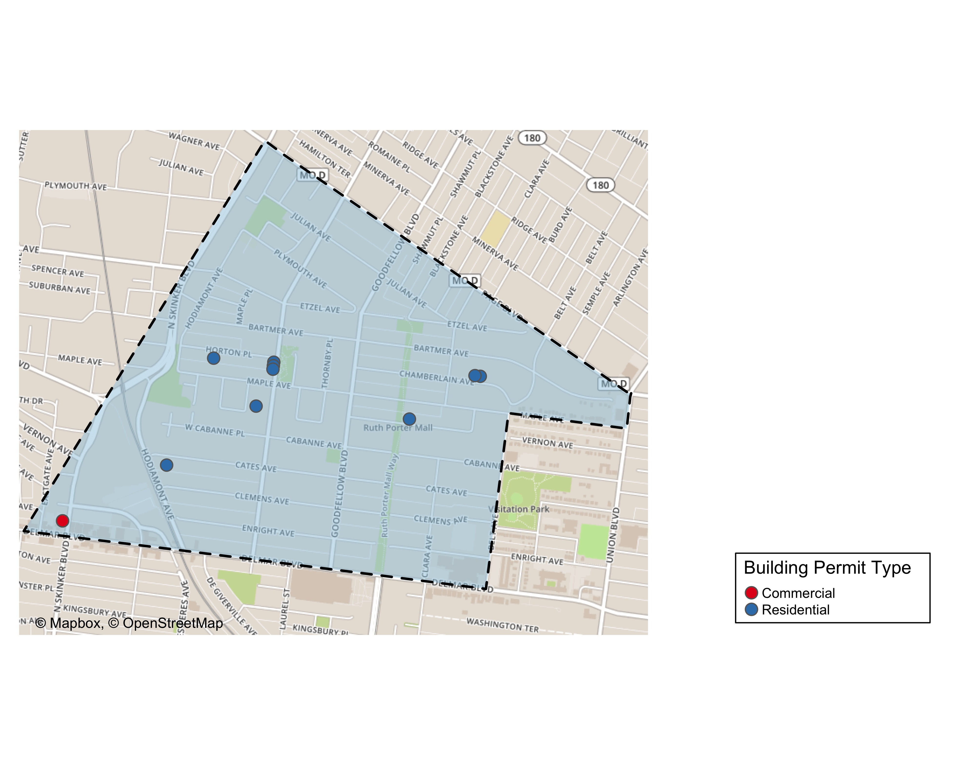

Slide 26
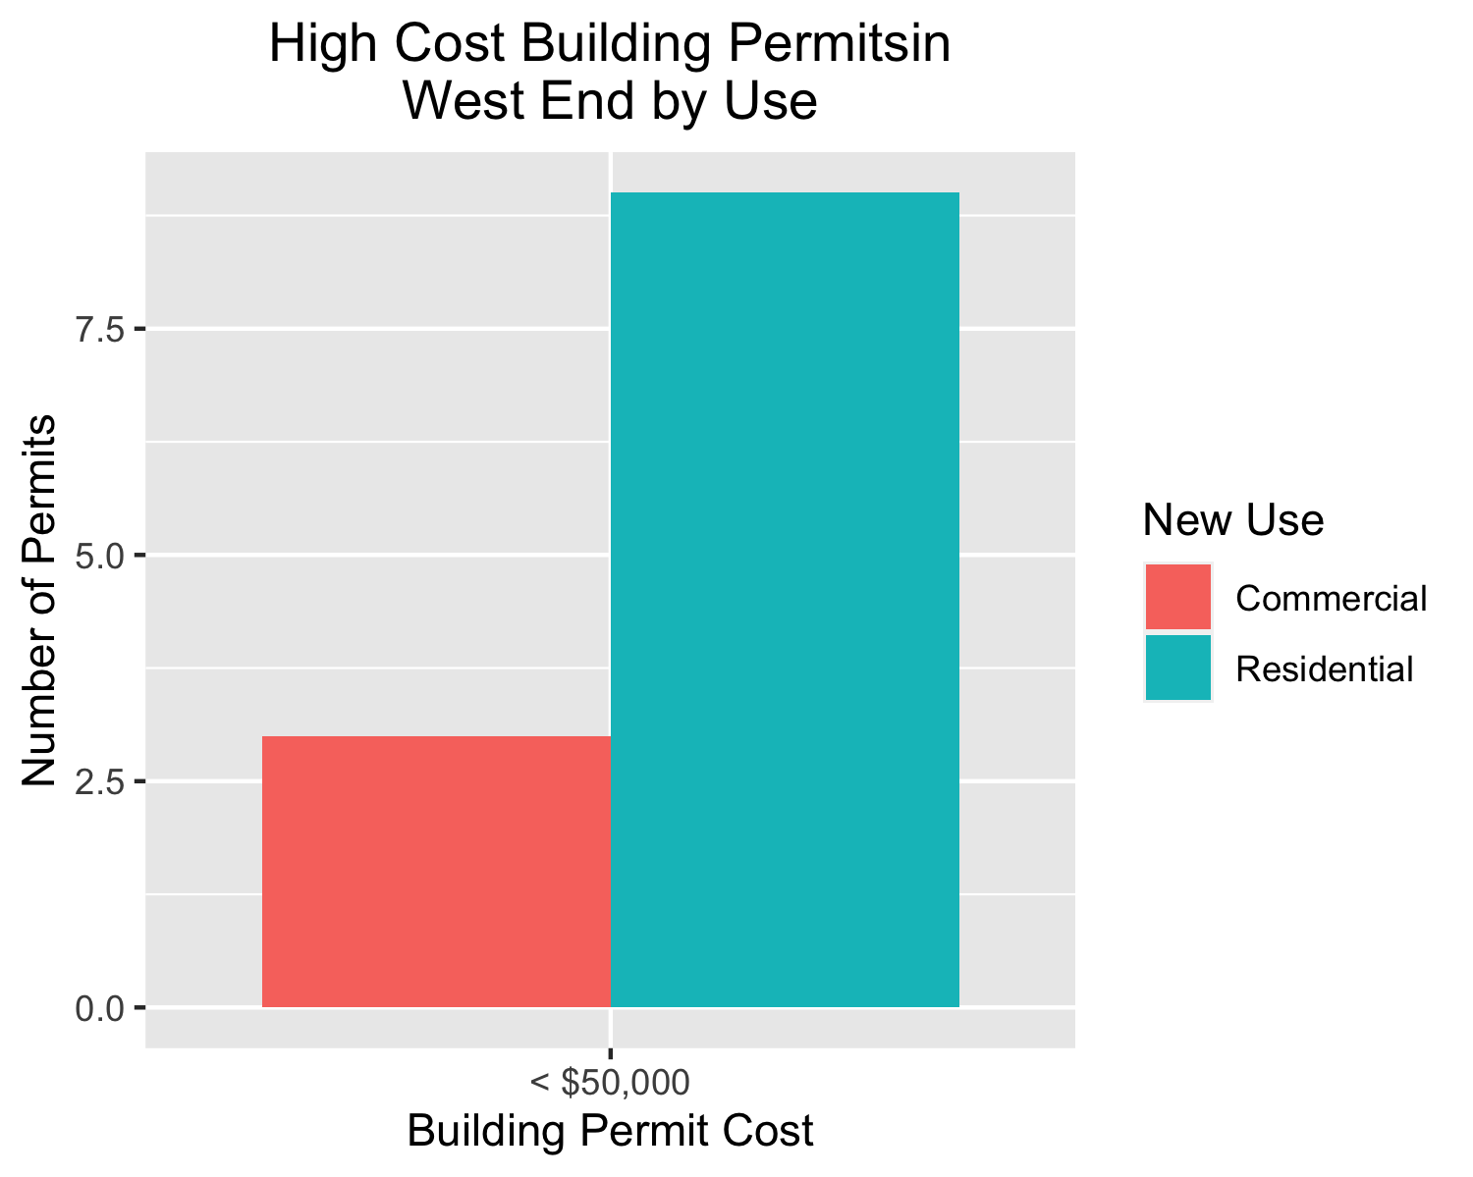

Slide 27
Visitation Park
0 building permits in Visitation Park in January 2020

Slide 28
Academy
6 building permits in Academy in January 2020

Slide 29
Owner | New Use | Cost | Address
MCCLENDON, GARY & GENA | Residential | $1,500 | 5021 MINERVA AV
GREEN LINE LLC | Residential | $200,000 | 5169 ENRIGHT AV
GREEN LINE LLC | Residential | $200,000 | 5167 ENRIGHT AV
MURPHY, CHRISTINA | Residential | $8,450 | 5101 CABANNE AV
ELDER, O TERRY | Institutional | $100,000 | 813 N KINGSHIGHWAY BLVD
JONES, ELLA M | Residential | $5,000 | 5207 RIDGE AV

Slide 30
New Use | Average Cost | Permit Count
Institutional | $100,000 | 1
Residential | $82,990 | 5

Slide 31
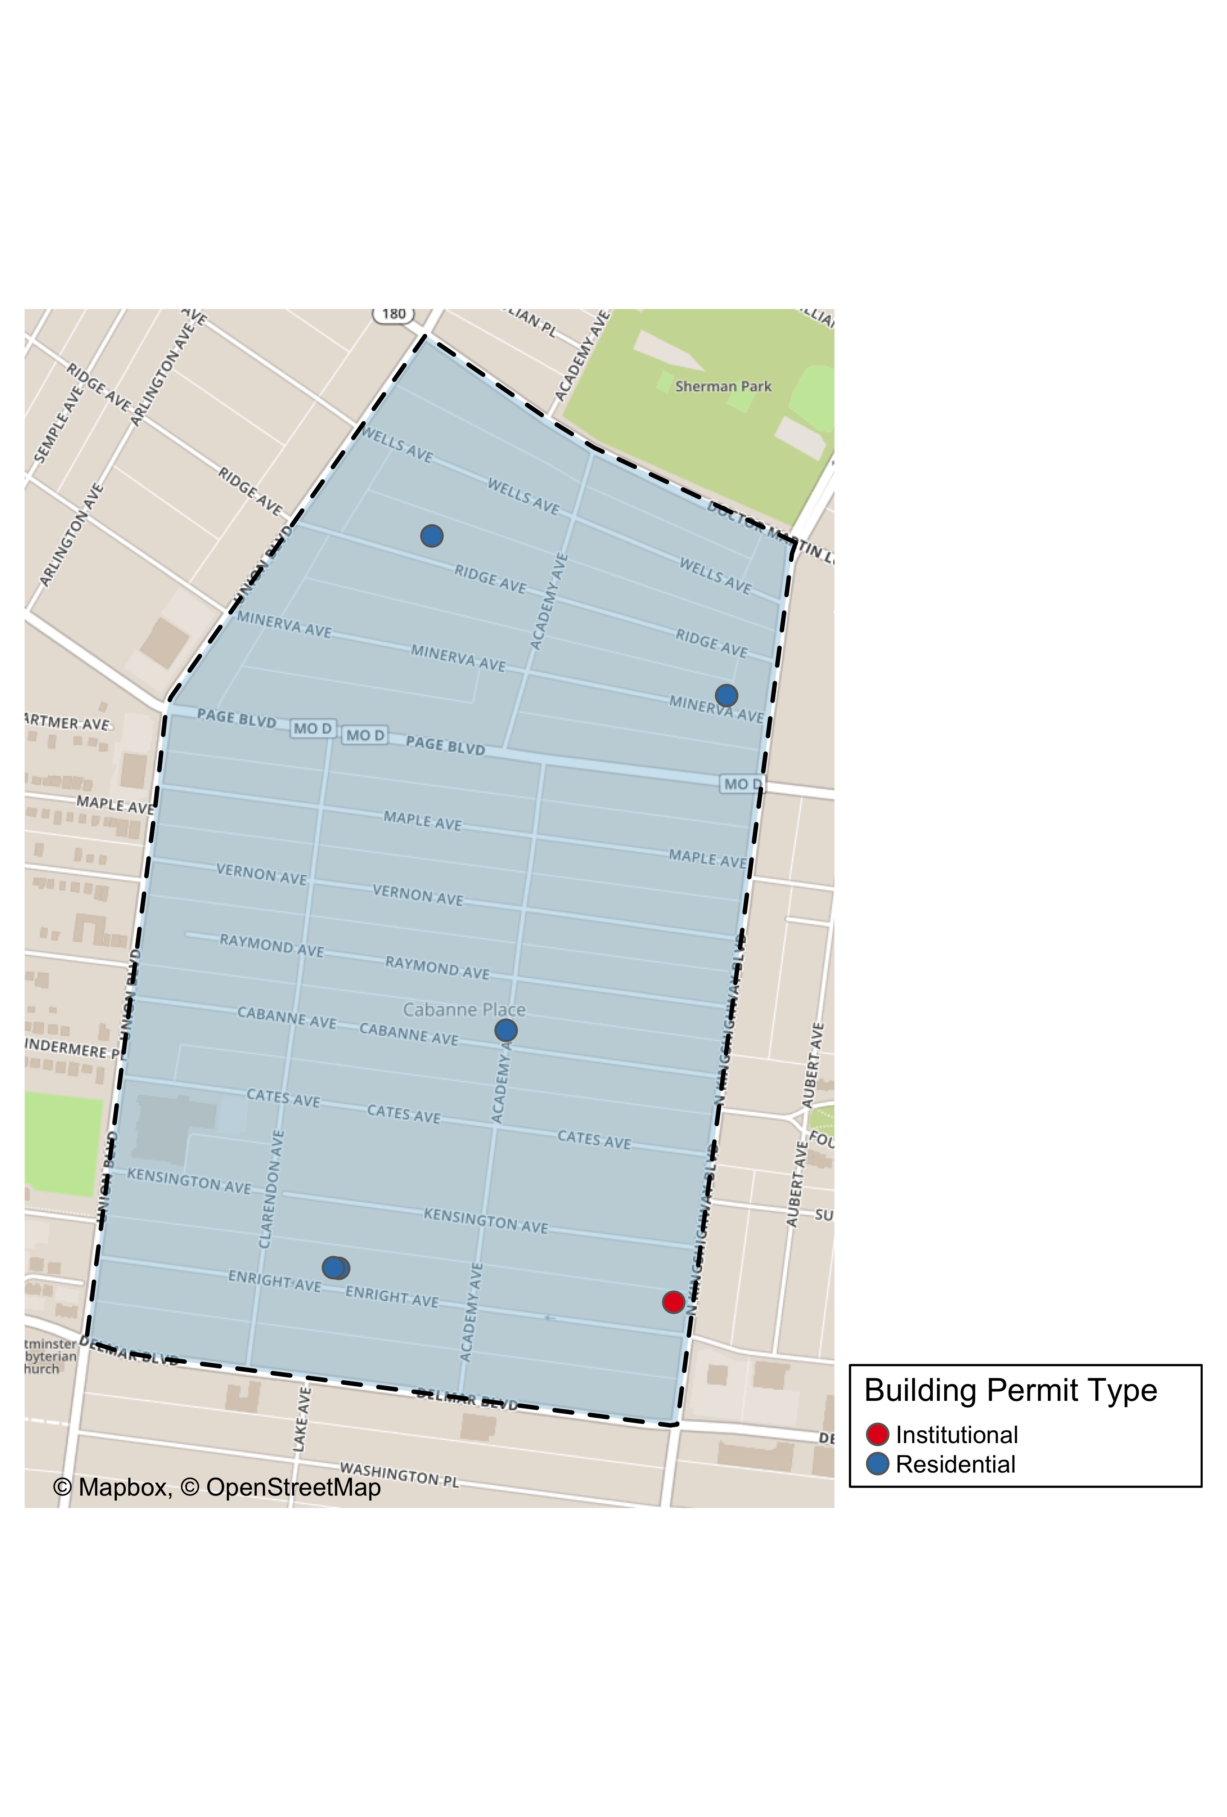

Slide 32
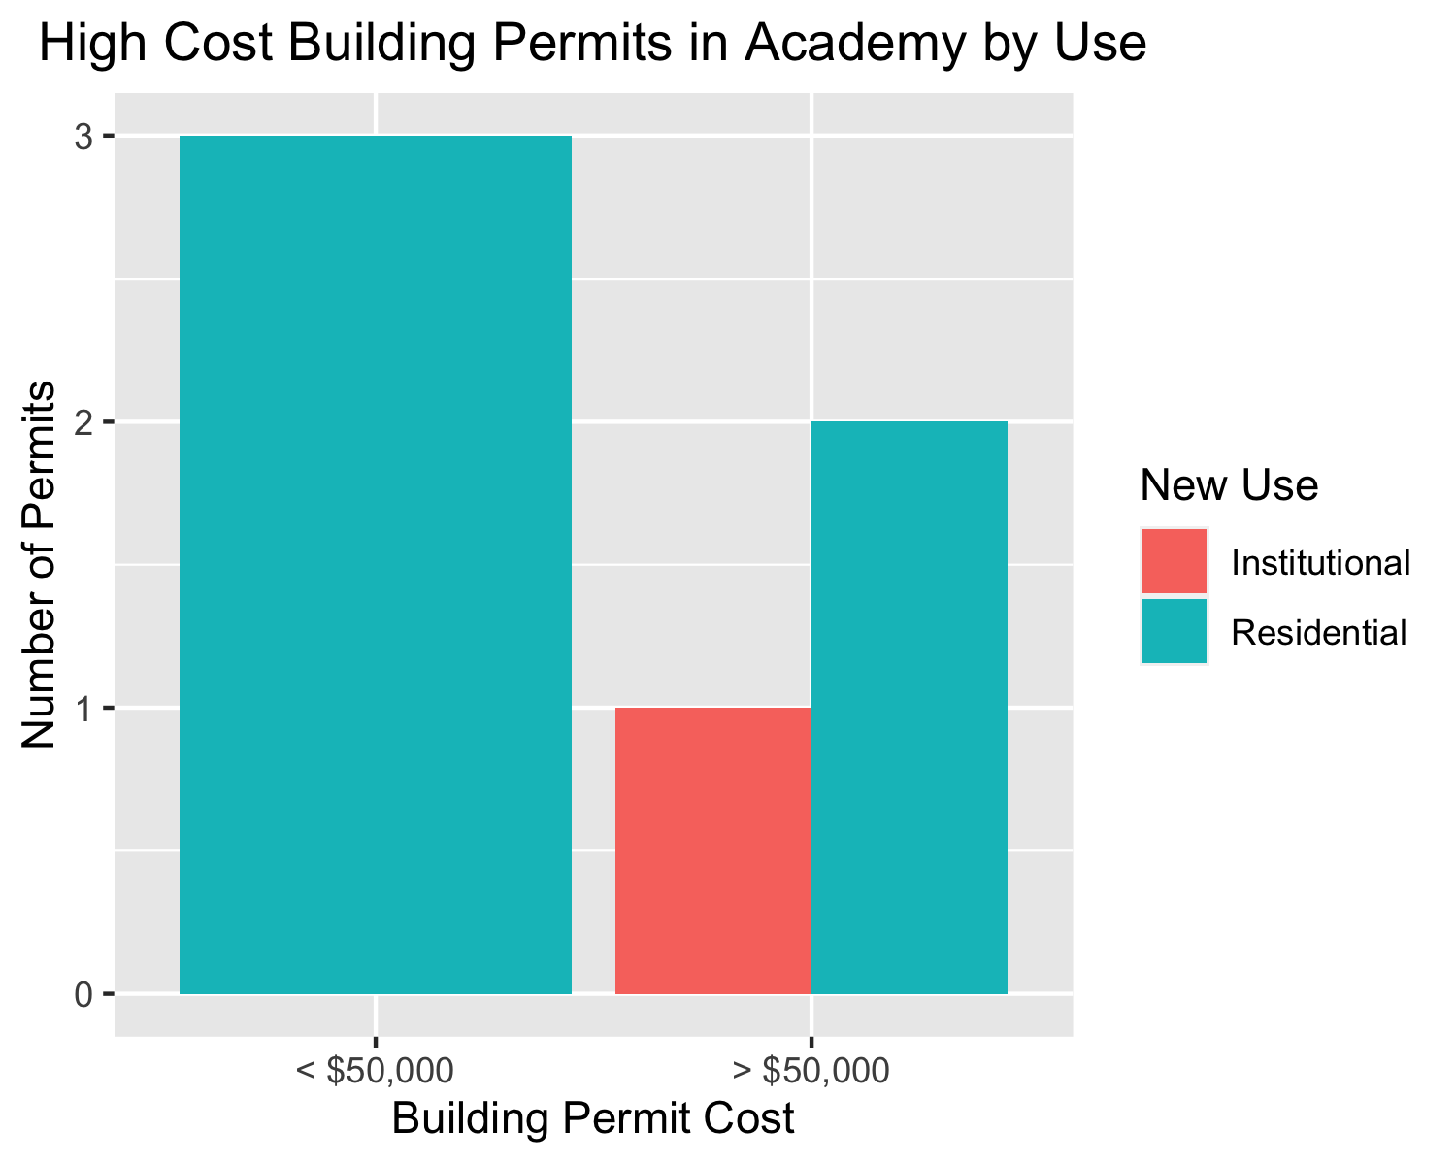

Slide 33
Fountain Park
0 building permits in Fountain Park in January 2020

Slide 34
Lewis Place
1 building permits in Lewis Place in January 2020

Slide 35
Owner | New Use | Cost | Address
GRAVES, JOHN E | Residential | $2,500 | 4727 PAGE BLVD

Slide 36
New Use | Average Cost | Permit Count
Residential | $2,500 | 1

Slide 37
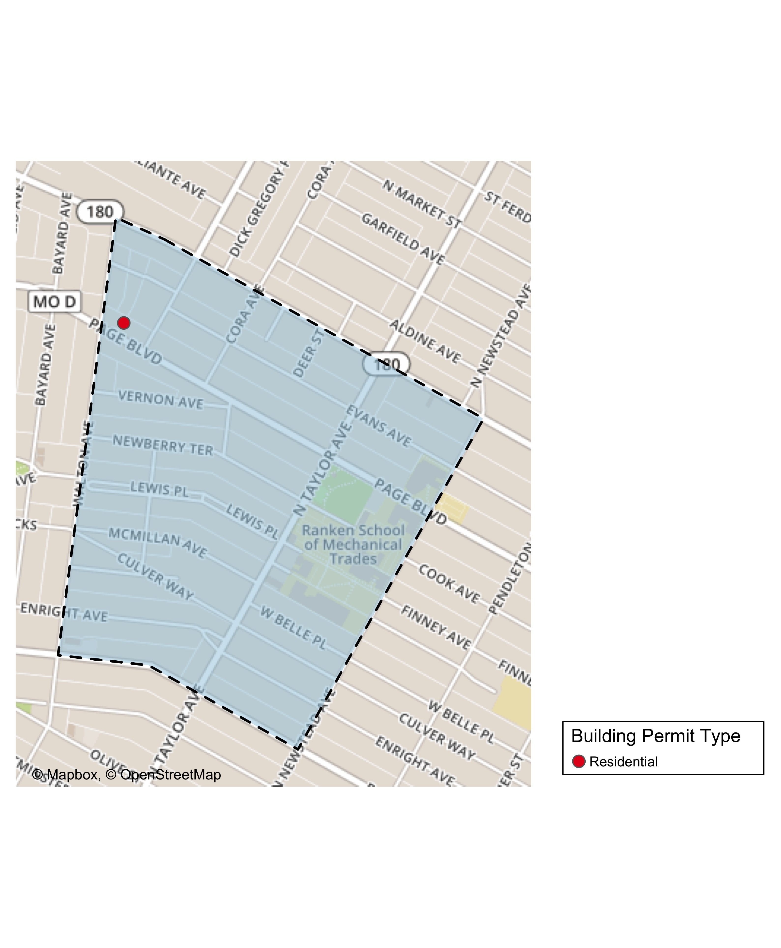

Slide 38
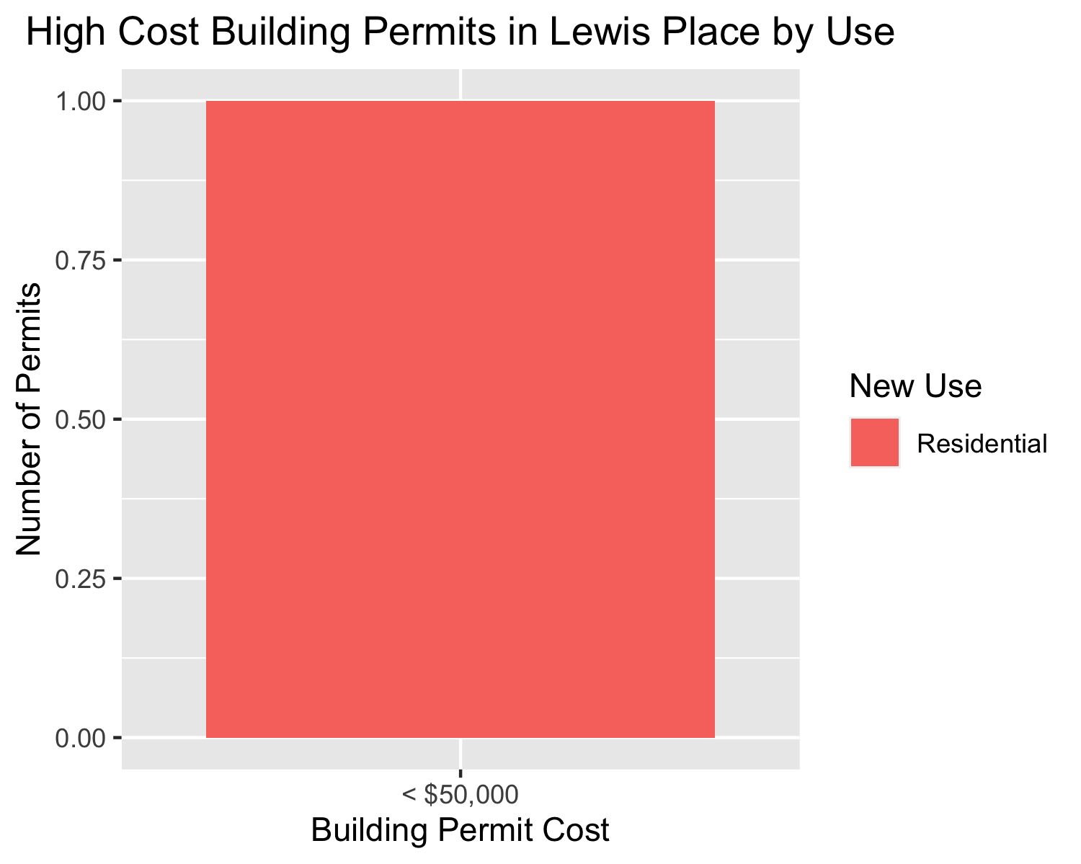

Slide 39
Vandeventer
2 building permits in Vandeventer in January 2020

Slide 40
Owner | New Use | Cost | Address
LOTT, JAMALIA | Residential | $150,000 | 4050 ENRIGHT AV
BROWN, TONY C SR & SHARON D BROWN | Industrial | $55,000 | 3960-66 PAGE BLVD

Slide 41
New Use | Average Cost | Permit Count
Industrial | $55,000 | 1
Residential | $150,000 | 1

Slide 42
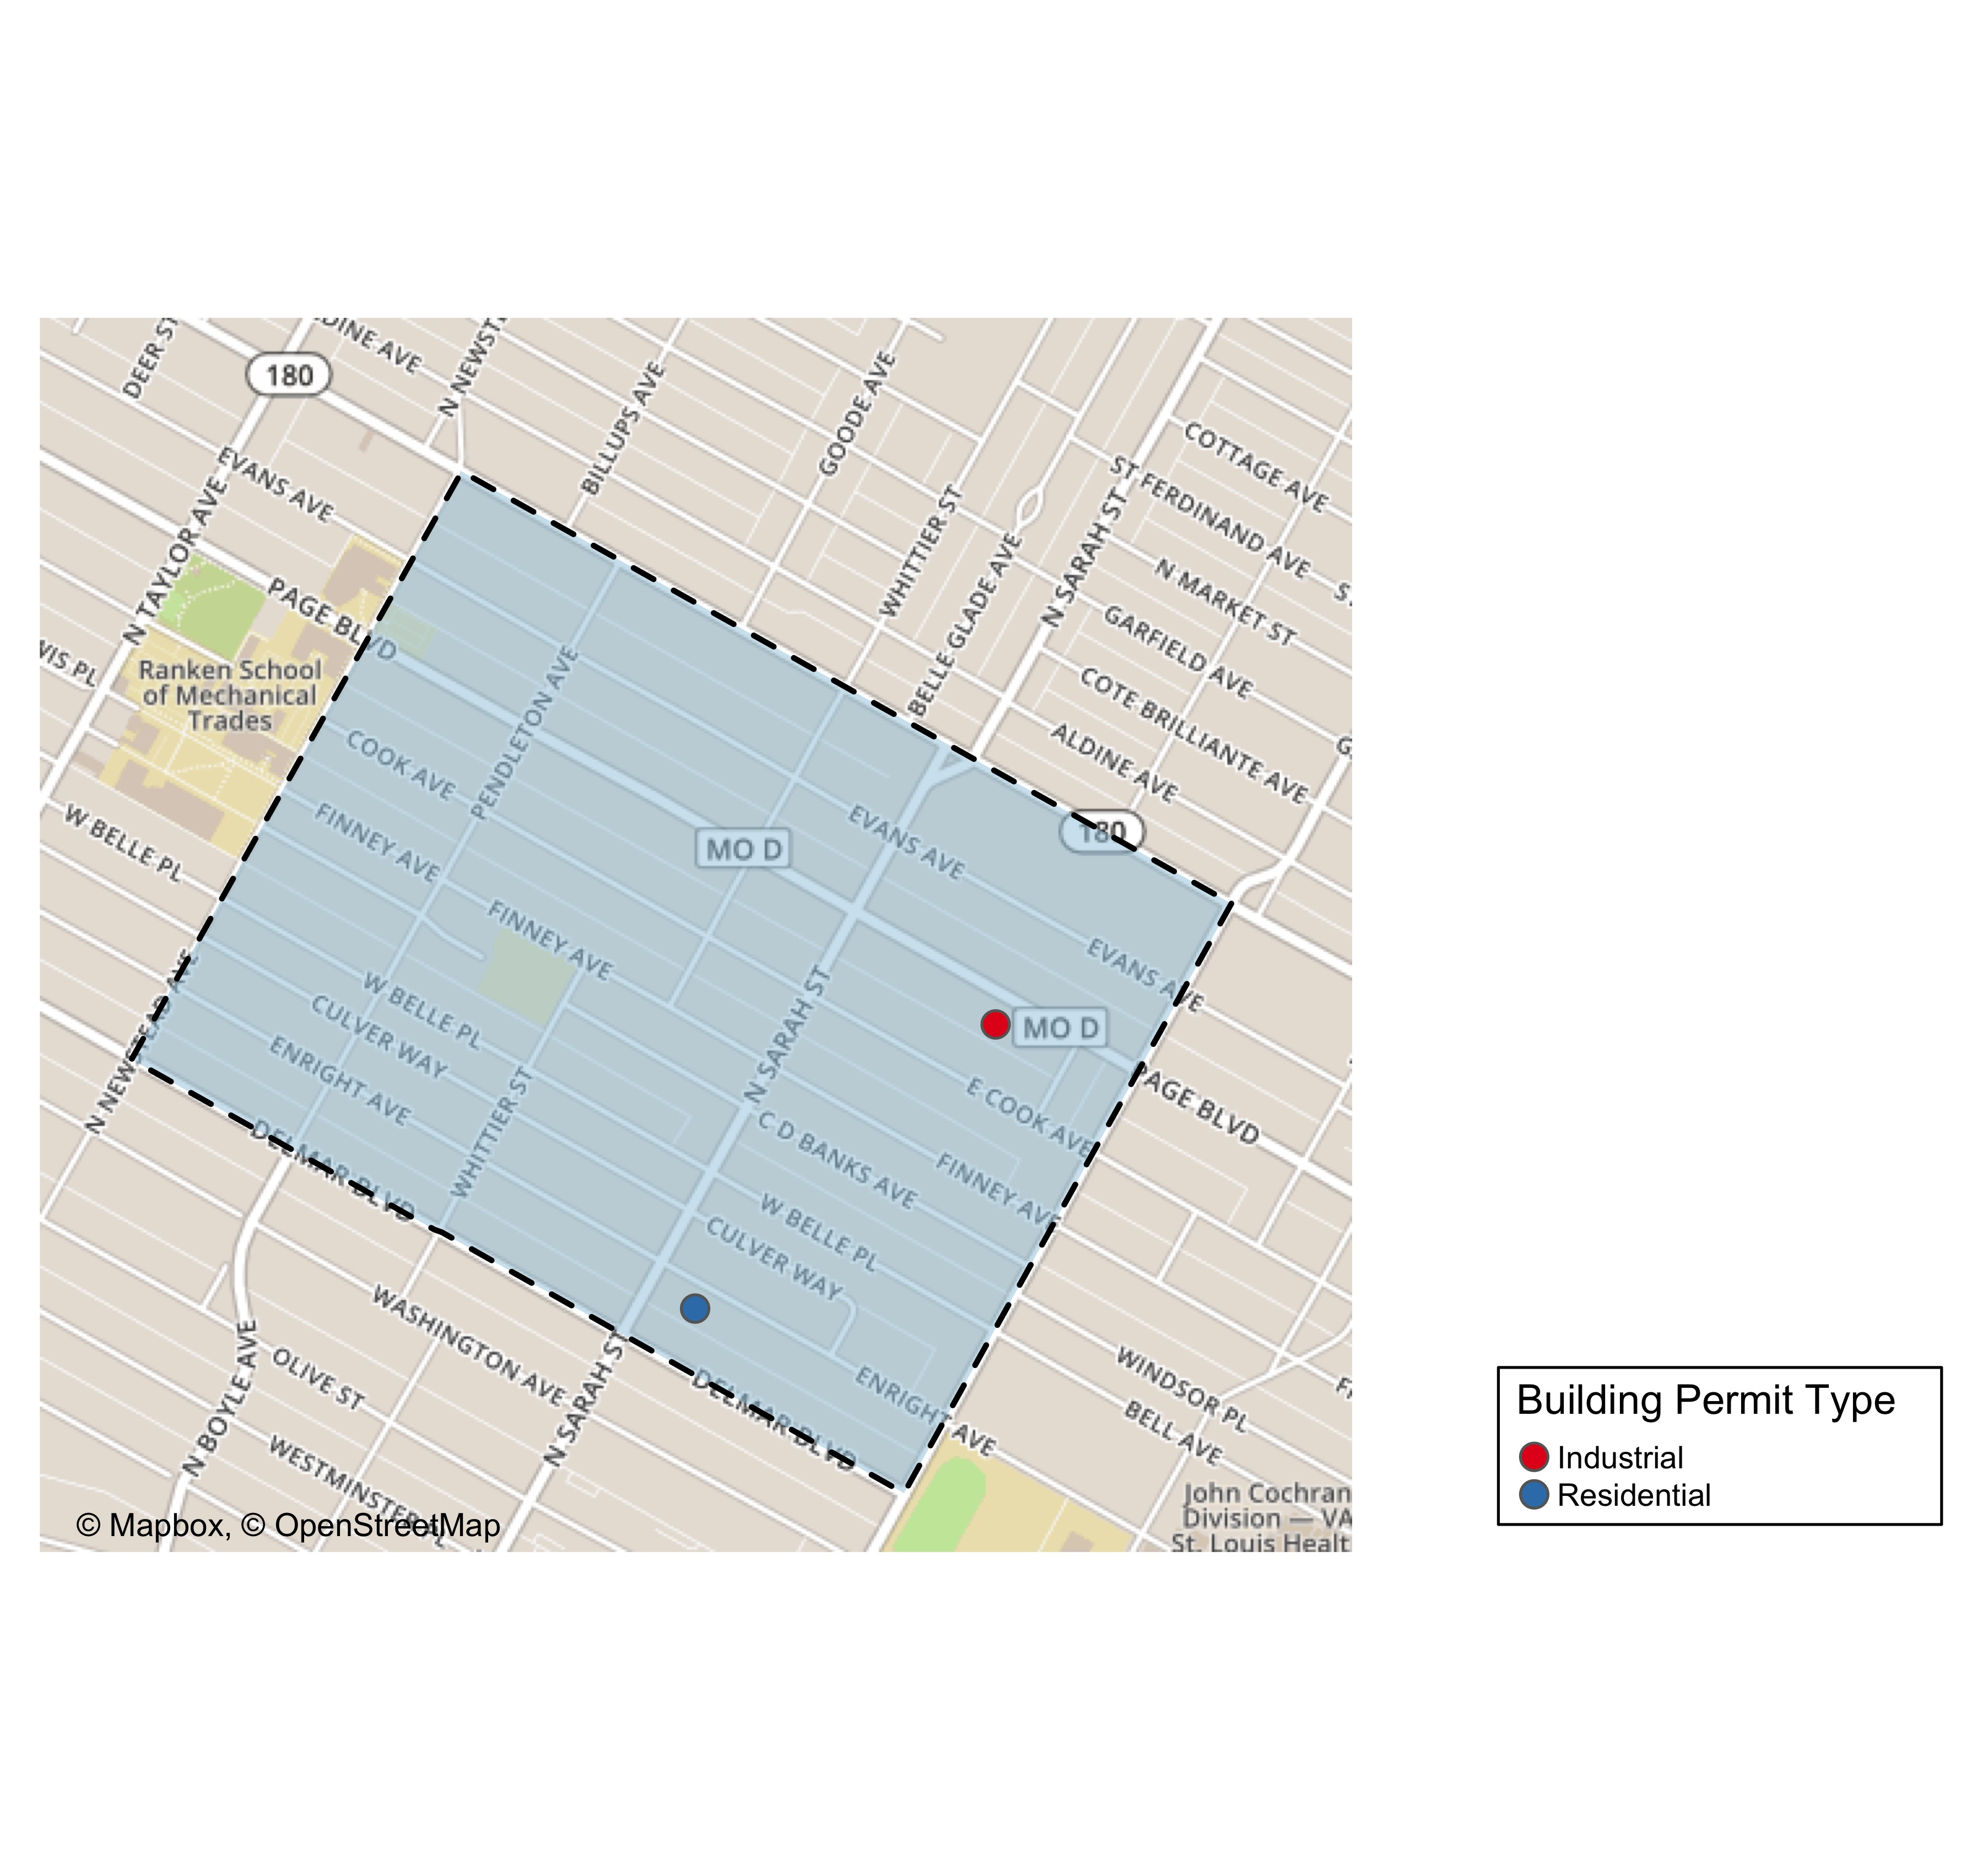

Slide 43
